Slide 1
PROSTATE & GYN hdr BRACHY IMPLANT
PROCEDURE
(Setup examples)
Edson herrera
Lead SURGICAL TECH, CRCST
UCLA RADIATION ONCOLOGY: division of hdr brachytherapy

Slide 2
DISCLAIMER
Please note that these slides serve as example(s) for HDR (prostate and GYN interstitial) procedure setup only. Please always defer to your institution’s policies and procedures and the orders of the treating physician.

Slide 3
PROSTATE BRACHY SEQUENCE
1. PROCTOSIGMOIDOSCOPY
USE A SMALL MAYO STAND TO SET UP SIGMOIDOSCOPE & SIGMOID KIT.
2. SKIN PREP
3. DRAPE
SCRUB TECH CAN BEGIN TO DRAPE. USING A STRAIGHT MAYO SCISSOR CREATE A BIGGER SURGICAL SITE. DOCTOR WILL INTRODUCE PROBE W/ STEPPER.
4. IMPLANT
6. CLOSE
MIDWAY THROUGH THE IMPLANT ON A SEPARATE MAYO STAND SET UP DENTAL PUTTY W/ 2 GRIDS.
CIRCULATING NURSE CAN BEGIN SKIN PREP.
LOCAL (IF APPLICABLE), LOAD ½ INCH TAPER NEEDLES TRACTION SUTURES X 2, IMPLANT FLEXINEEDLES, SPACEOAR, GOLD ANCHOR MARKER SEEDS (INITIAL IMPLANT).
5. CYSTOSCOPY
EXAMINATION OF THE IMPLANT, TO ASSURE NO CATHERS HAVE ENTERED THE BLADDER.

Slide 4
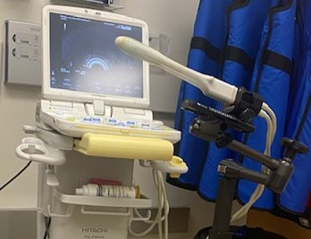
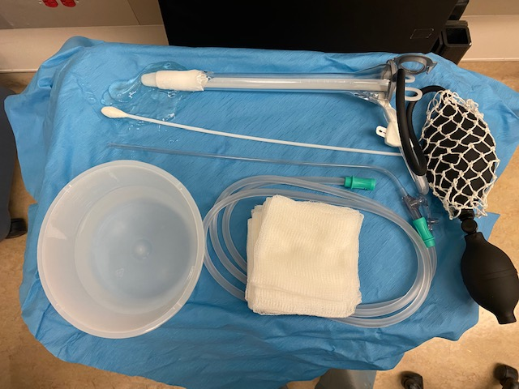
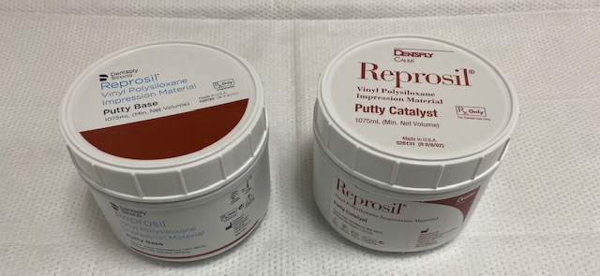
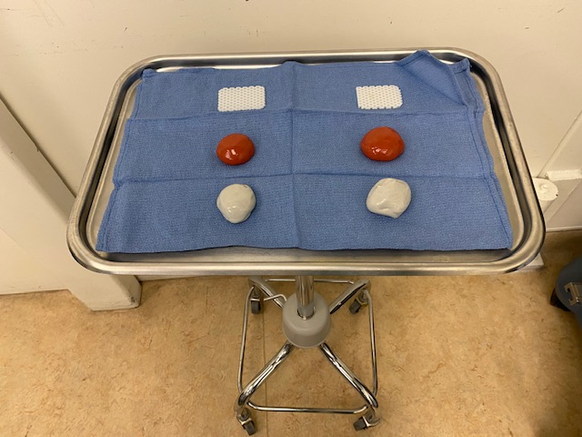
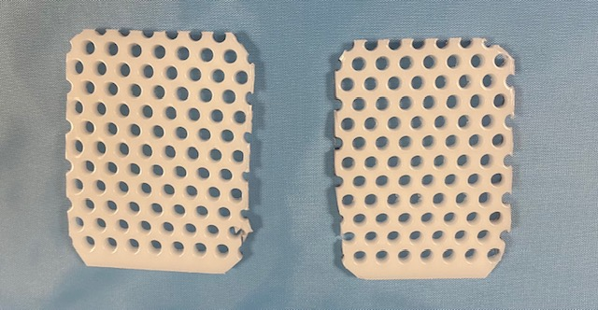
Hdr brachy PROSTATE
EQUIPMENT & SUPPLIES SET UP
  NOT STERILE!
ULTRASOUND MACHINE (NOBLUS)
stepper
TRANSRECTAL HITACHI PROBE
PROCTOSIGmoidoscopy KIT
Dental putty
2 GRIDS
  NOT STERILE!

Slide 5
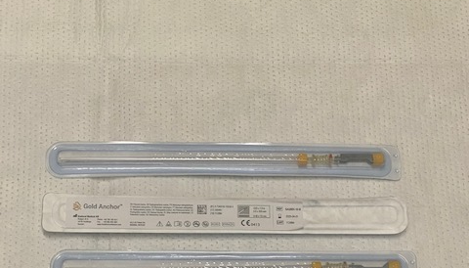
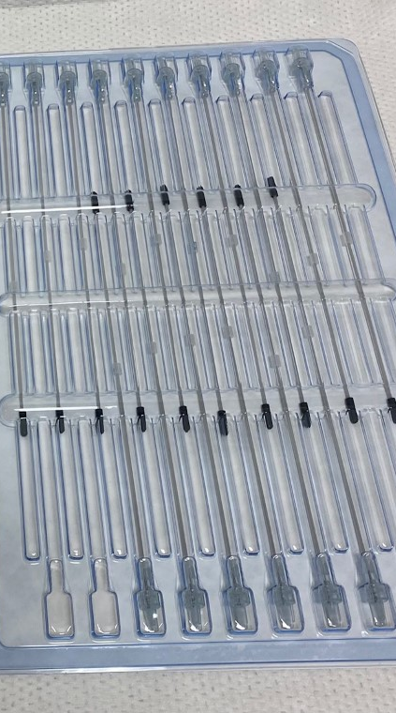
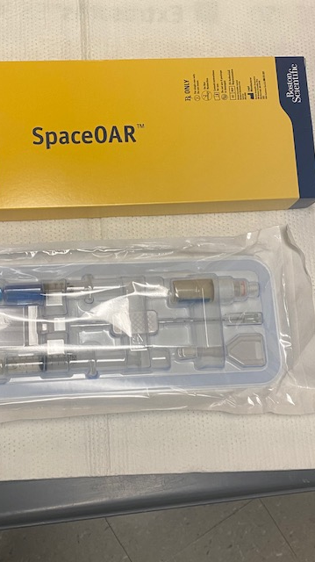
Prostate HDR: IMPLANTs & FLeXI NEEDLES
SPACEOAR (IF applicable, USED IN Initial IMPLANT ONLY)
GOLD MARKER ANCHOR FIDUCIAL SEEDS (Initial IMPLANT ONLY)
FLEXI NEEDLES

Slide 6
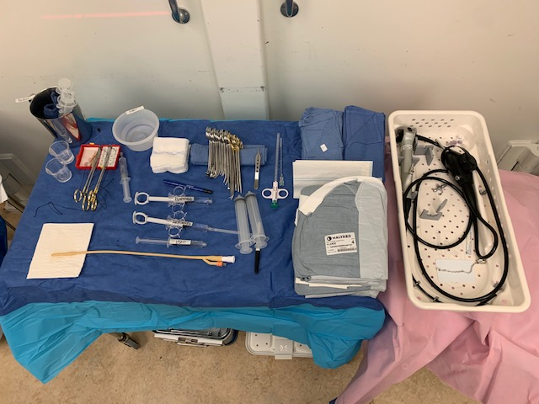
PROSTATE HDR:
BACK TABLE
SET UP
PROSTATE TRAY
FLEXIBLE CYSTOSCOPE
PITCHER (WITH SALINE)
BASIN (WITH H20)
BIOPSY INSTRUMENT W/ COAXIAL NEEDLE (IF APPLICABLE)

Slide 7
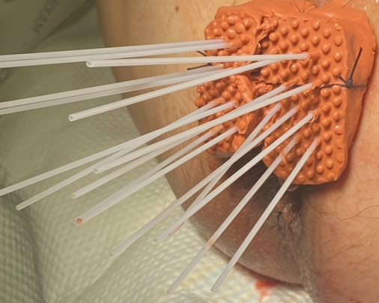
PROSTATE HDR
IMPLANT → COMPLETE

Slide 8
GyN Interstitial HDR BRACHYTHERAPY:
PROCEUDRE SEQUENCE
1. PROCTOSIGMOIDOSCOPY
USE A SMALL MAYO STAND TO SET UP SIGMOIDOSCOPE & SIGMOID KIT.
2. SKIN PREP
3. DRAPE
SCRUB TECH CAN BEGIN TO DRAPE, USING A STRAIGHT MAYO SCISSOR CREATE A BIGGER SURGICAL SITE.
5. IMPLANT
6. CLOSE
CREATE A BOLSTER USING 4 ½ IN. KERLIX ROLL (FOLD KERLIX IN 3 LAYERS), LOAD A MAYO TROCAR NEEDLE W/ (#2) SILK TIES TO HOLD VAG. TEMPLATE AND BOLSTER IN PLACE. (REPEAT A TOTAL OF 4 TIMES.)
CIRCULATING NURSE CAN BEGIN SKIN PREP.
LOCAL (IF APPLICABLE) LOAD TAPER NEEDLES TRACTION SUTURES X 2, IMPLANT FLEXINEEDLES, GOLD ANCHOR MARKER SEEDS (INTIAL IMPLANT).
4. CYSTOSCOPY
EXAMINE BLADDER (IF DOCTOR REQUEST)

Slide 9
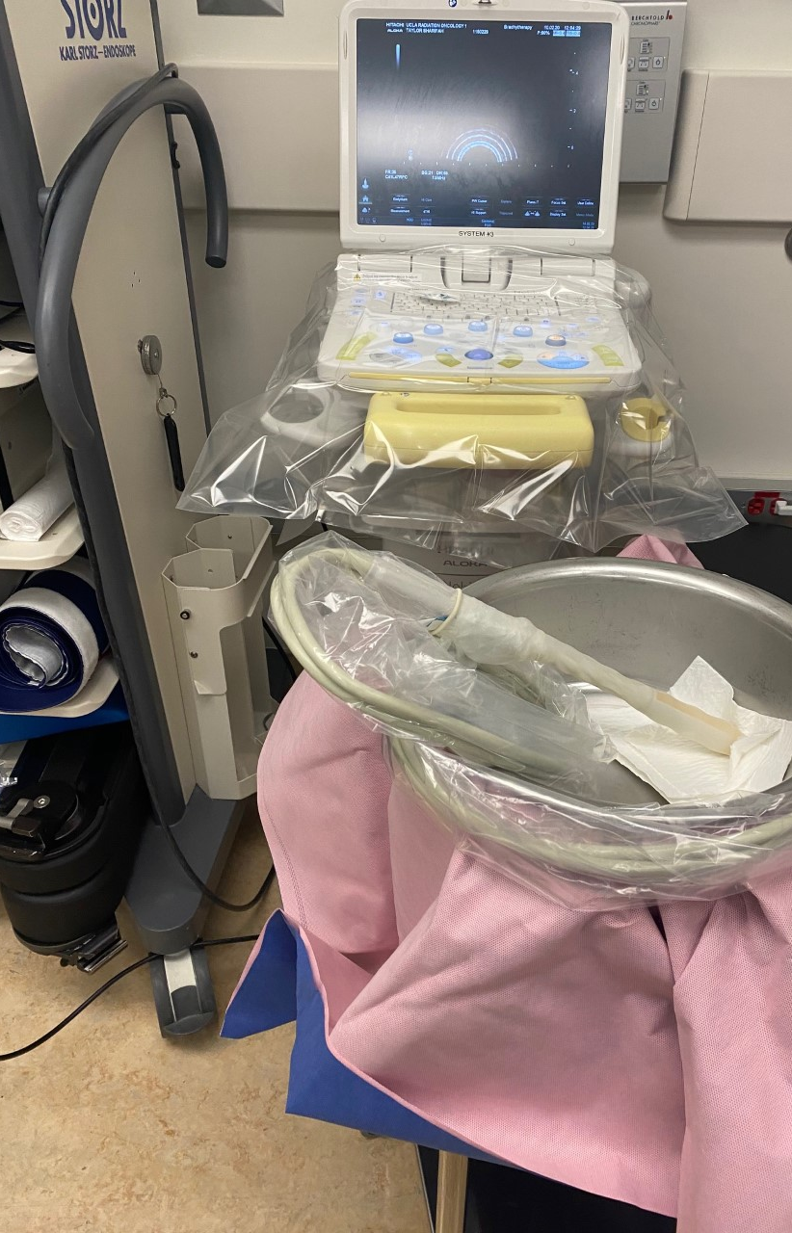
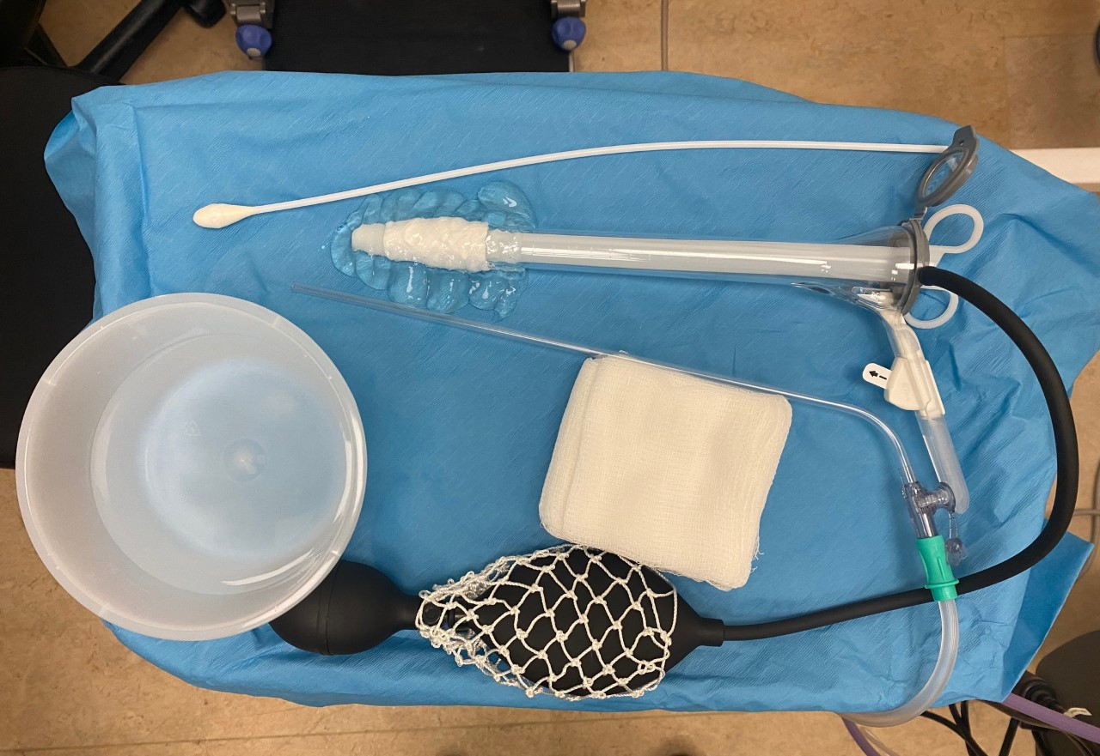
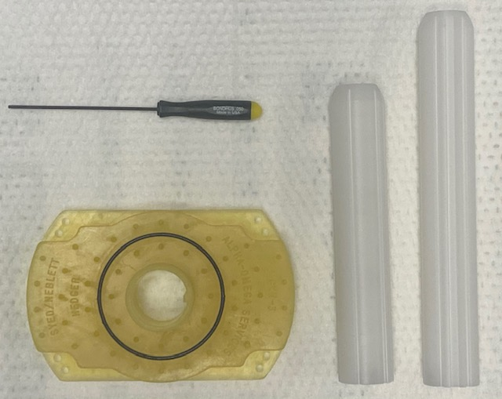
GYNecologic Interstitial HDR:
EQUIPMENT & SUPPLIES SET UP
  NOT STERILE!
ULTRASOUND MACHINE (NOBLUS)
TRANSRECTAL HITACHI PROBE
PROCTOSIG kit
VAGINAL TEMPLATE
VAGINAL CYLINDER (12CM & 15CM)
HEX SCREWDRIVER

Slide 10
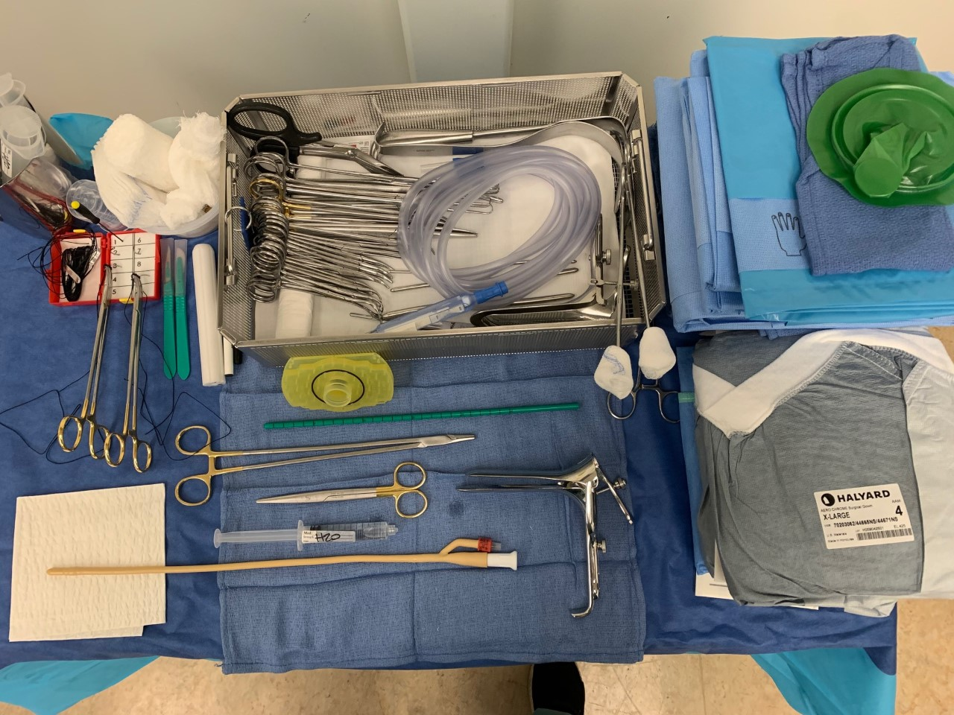
GyN interstitial hdr brachy:
BACK TABLE
GYN TRAY
VAGINAL TEMPLATE
VAGINAL CYLINDER (12CM OR 15CM)
PITCHER (WITH H20)

Slide 11
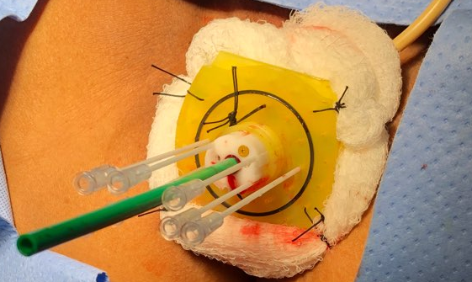
GYN interstitial HDR Brachytherapy
IMPLANT → COMPLETE

